Slide 1
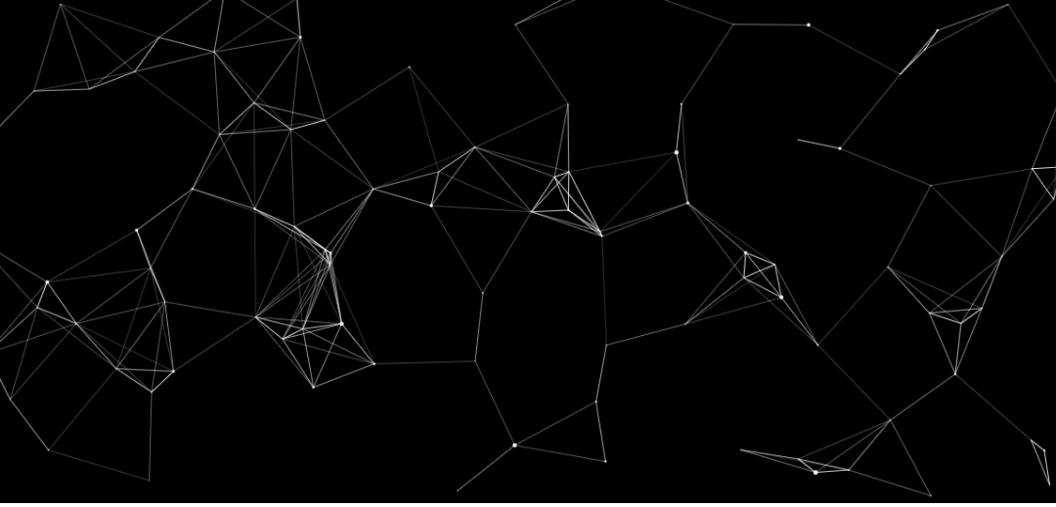

19 DECEMBER 2023
Python for computational problem solving(PCPS)
subject code:UE23CS151A
MINIPROJECT
SEMESTER -1
"SPEECHIFY"
Team details:
Keerthan P.V.-PES2UG23CS272
Prajwal B.C.-PES2UG23CS420
Prajwal R.V.-PES2UG23CS423
Mahesh I.A.-PES2UG23CS316
Under the guidance of
Prof. Umme Haani
Dept of CSE
PES University

Slide 2

PROBLEM STATEMENT
SPEECHIFY innovates reading by converting PDFs to speech, transcribing spoken words to text and facilitating translation, redefining our approach to written content interaction worldwide.
​

Slide 3
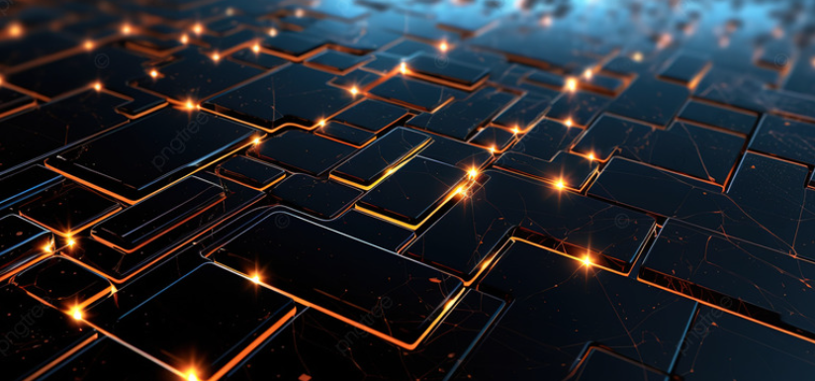
TEAM ROLES AND RESPONSIBILITES
KEERTHAN P.V.
KEERTHAN P.V.
PRAJWAL R.V.
-speech to text interface
-error handling
-text box designs
-label designs
-text translator interface
-translational management
-ppt presentation
PRAJWAL B.C
MAHESH I.A.
- selection menu interface
-testing
-ppt presentation
-PDF reader interface
-language management
-code modifications
-testing

Slide 4
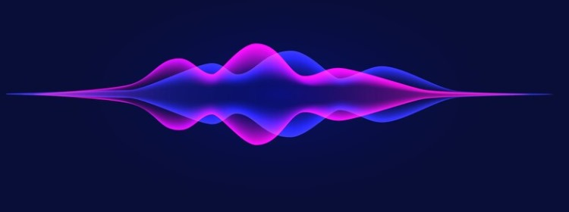
LISTS OF INBUILT MODULES WITH ITS FEATURES
KEERTHAN P.V.
1. tkinter: This module is used for creating the graphical user interface (GUI).
2. gtts (Google Text-to-Speech): This module is used for converting text to speech using Google Text-to-Speech API.
3. io: This module provides the BytesIO class, which is used for handling binary data as a file-like object in memory.
4. googletrans: This module is used for translating text using Google Translate.
5. playsound: This module is used for playing sound on various platforms.

Slide 5

IMPLEMENTATION DETAILS
1. Speech-to-Text:
- Use a speech recognition API for real-time conversion of spoken words to text.
2. PDF Reading:
- Integrate a PDF parsing library to extract and read text content from uploaded PDFs.
3. Translation:
- Implement a language translation API for seamless conversion between languages.
4. User Interface:
- Design an intuitive interface for speech input, PDF upload, and language selection.
5. Text-to-Speech (TTS):
- Utilize a TTS engine to convert text into spoken words for a comprehensive user experience.
6. Error Handling:
- Implement robust error handling and input validation for a smooth user interaction.
7. Testing and Optimization:
- Conduct thorough testing and optimize performance for speed and resource efficiency.

Slide 6
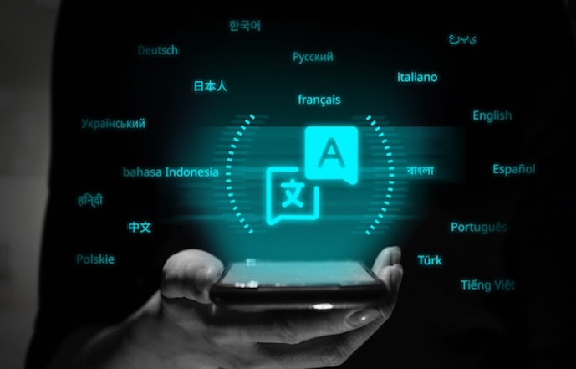
LEARNING FROM THE PROJECT
Speechify taught the critical role of rigorous testing and user feedback in refining accuracy and usability. This emphasizes the adaptability and user-centric design.

Slide 7

RESULTS AND OUTPUT
1. Overall System Performance:
- Summarize the overall performance of the Speechify system.
- Discuss any interdependencies between different modules.
2. User Feedback and Usability:
- Present aggregated user feedback and discuss how it influenced any modifications.
- Address any reported usability issues and proposed solutions.
3. Future Improvements:
- Identify areas for future development or enhancement.
- Consider user suggestions and potential feature additions.

Slide 8
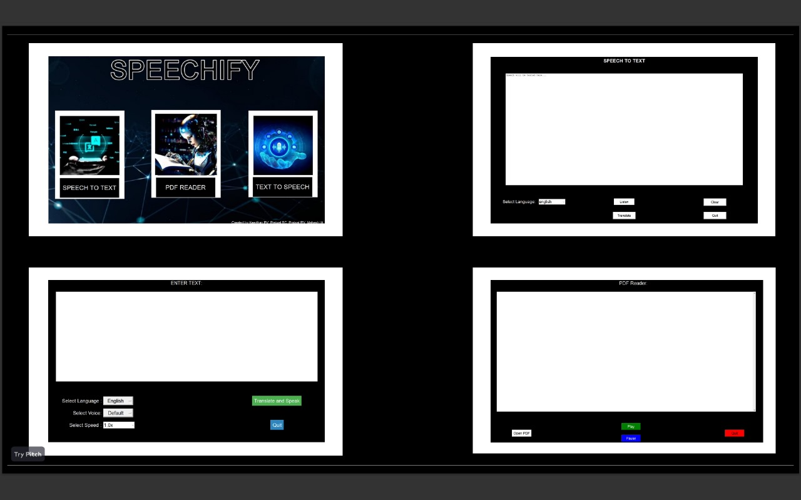

Slide 9
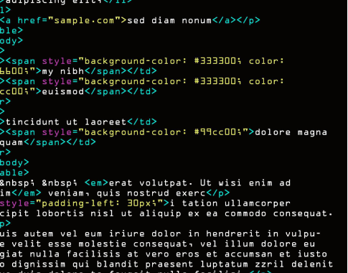
CONCLUSION
Speechify integrates diverse language processing features, showcasing effectiveness through rigorous testing and user feedback. Ongoing improvements are prioritized for enhanced accuracy and usability, emphasizing its potential for inclusive and user-friendly applications. The project marks a promising step forward in the realm of comprehensive communication tools.

Slide 10
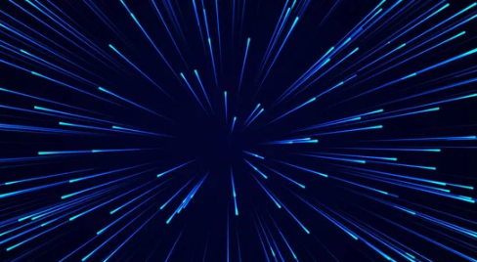
FUTURE WORK:
To develop the app that translates the language of the speaker into different languages during the call so as to avoid the language barrier in a multi-lingustic country like India.
REFERENCES:
chatgpt-3.5
google
brandcrowd

Slide 11
